Slide 1
Randomized Algorithms and Simulated Annealing
Yiming ZHANG

Slide 2
Outline
1. About Randomized Algorithms
The Limits of Determinism: Why We Need Randomness
Purposeful Uncertainty : What are Randomized Algorithms
Monte Carlo methods 蒙特卡洛方法
Las Vegas algorithms 拉斯维加斯算法
2. Simulated Annealing（SA）
Method of Climbing & Limitation
Algorithm Implementation
Further – About Genetic Algorithm (GA) 遗传算法

Slide 3

Why Random：The strength of Computer Program
Strength
Absolute Precision：Basic arithmetic operations are error free
绝对精度，基本算术运算不会出错
High Speed: Billions of deterministic operations per second.
高速，每秒可完成数亿次操作
Perfect Reproducibility: Same input always correspond to same output
完美可重复性，相同输入永远对应相同输出
Conceptual Simplicity: Follows logical, predictable operation paths.
概念精简性，遵循有逻辑的，可预测的执行路径

Slide 4
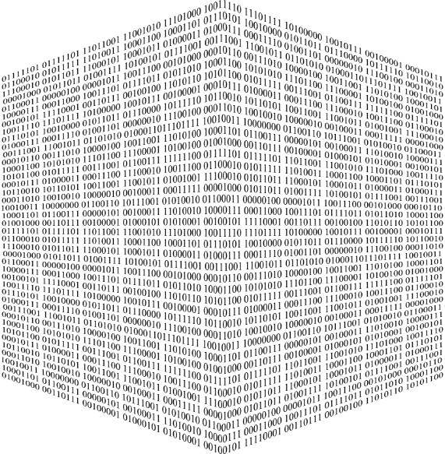
Why Random：The Weakness of Computer Program
Weakness:
Combinatorial Explosion: Solution space grows exponentially with the size of the problem
组合爆炸：解集空间随问题规模指数级增长
Sparse High-Dimensional Data: For high-dimensional problems, each data point inhabits a vast, mostly vacant feature space
高维数据稀疏：在高维问题中，每个数据点都位于一个巨大的、大部分为空的特征空间中
Trade-Off Dilemma: Difficult to make accurate decision facing equivalent state
决策困境：在等效状态下难以做出准确决策

Slide 5
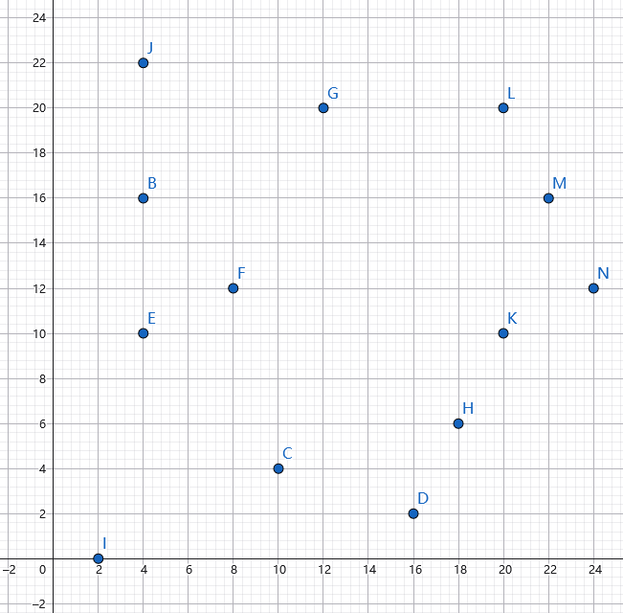
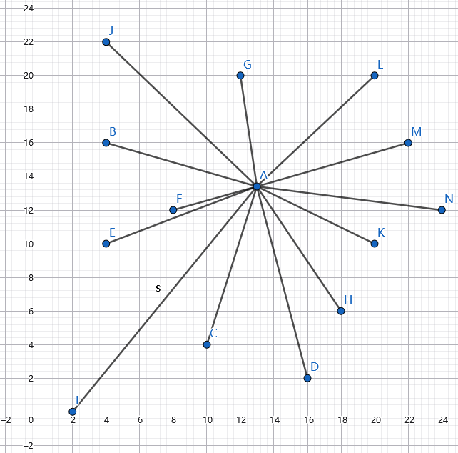
Example: The Fermat Point Problem 费马点问题

Slide 6
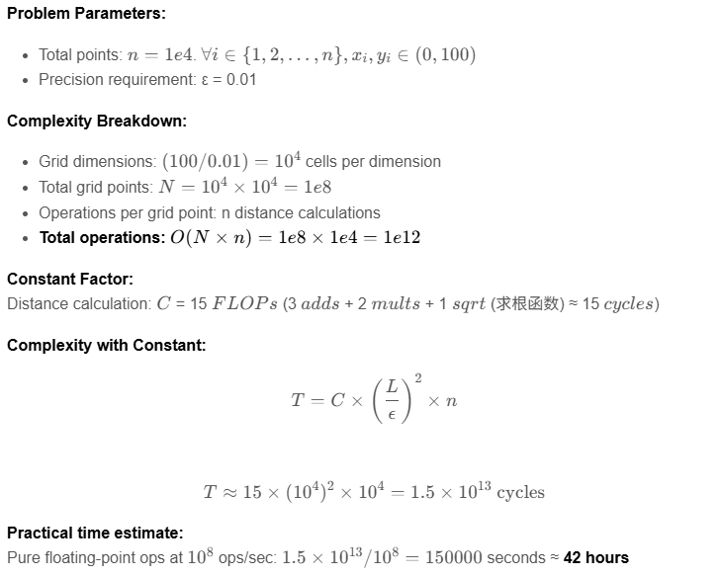

Example: The Fermat Point Problem 费马点问题

Slide 7
Example: The Fermat Point Problem 费马点问题

Slide 8
Example: The Fermat Point Problem 费马点问题
We can give program “intuition” by introducing randomization

Slide 9

What is Randomized Algorithms
Definition
An algorithm that uses random numbers or random selections during execution to influence its behavior, performance, or output. Its correctness or operational efficiency is guaranteed by probability, without absolute certainty.
一种在执行过程中使用随机数或随机选择来影响其行为、性能或输出的算法。其正确性或运行效率由概率保证，而无绝对确定性。
Core Concept
Random Sampling: use parts to represent the whole, estimating complex variable
随机抽样：用局部代表整体，估算复杂变量
Randomized Choice: Average performance, avoiding worst-Case state
随机选择：平均化性能，避免最坏状态
Randomized Perturbation: Escape local optima, searching for a global optimum
随机扰动：逃离局部最优, 寻找全局最优

Slide 10
Monte Carlo methods
Basic Principle
The Monte Carlo method is a randomized algorithm that uses model construction and random sampling to obtain approximate results. Its running time is usually deterministic, but the result may have some probability of error. It always returns an answer within a finite time, but that answer may be correct with a certain probability
蒙特卡洛方法是一种随机化算法，它通过模型构筑和随机采样来获得近似解，其运行时间通常是确定的，但结果可能以一定的概率存在误差。它总是能在有限时间内返回一个答案，但是该答案有一定概率错误
Feature
Solving determinism with randomness
Correctness is probabilistic → often with good expected performance
Particularly powerful for high-dimensional, complex systems

Slide 11
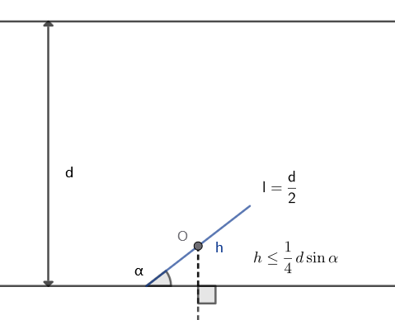
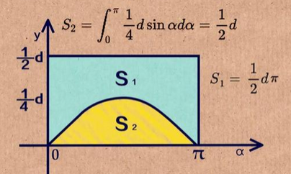
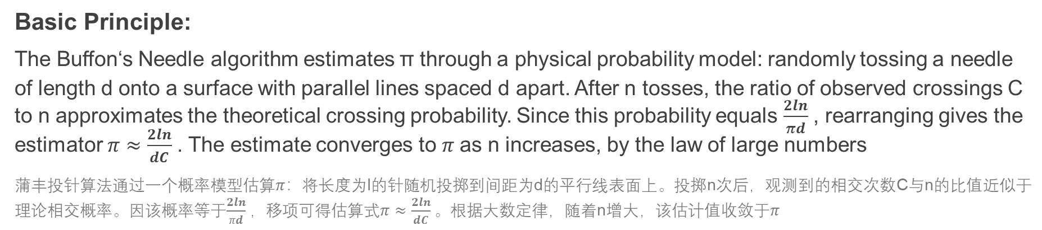
Example: Estimating π
Basic Principle:
The Buffon‘s Needle algorithm estimates π through a physical probability model: randomly tossing a needle of length d onto a surface with parallel lines spaced d apart. After n tosses, the ratio of observed crossings C to n approximates the theoretical crossing probability. Since this probability equals $\frac{2ln}{πd}$, rearranging gives the estimator $π≈\frac{2ln}{dC}$. The estimate converges to$π$ as n increases, by the law of large numbers
蒲丰投针算法通过一个概率模型估算$π$：将长度为l的针随机投掷到间距为d的平行线表面上。投掷n次后，观测到的相交次数C与n的比值近似于理论相交概率。因该概率等于$\frac{2ln}{πd}$，移项可得估算式$π≈\frac{2ln}{dC}$。根据大数定律，随着n增大，该估计值收敛于$π$

Slide 12
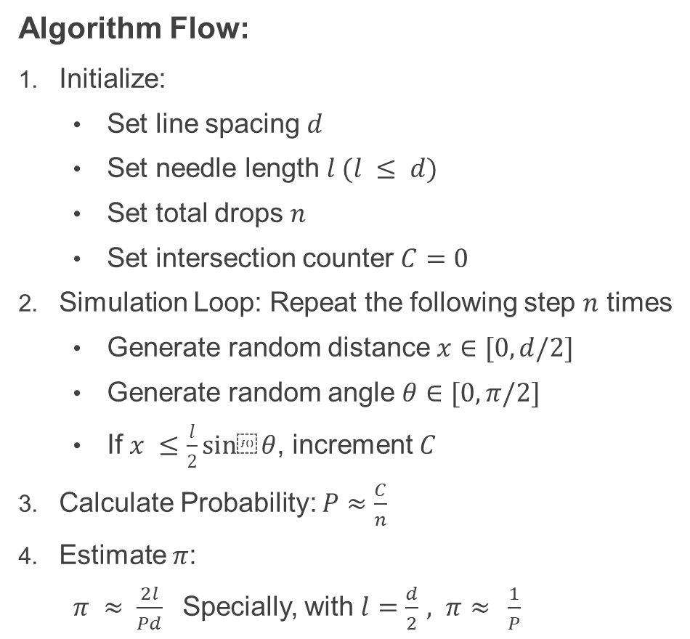
Example: Estimating π
Algorithm Flow:
Initialize:
Set line spacing $d$
Set needle length $l (l ≤ d)$
Set total drops $n$
Set intersection counter $C=0$
Simulation Loop: Repeat the following step $n$ times
Generate random distance $x∈[0,d/2]$
Generate random angle $θ∈[0,π/2]$
If $x ≤\frac{l}{2}sin⁡θ$, increment $C$
Calculate Probability: $P≈\frac{C}{n}$
Estimate$π$:
$π ≈ \frac{2l}{Pd}$ Specially, with $l=\frac{d}{2}$ $, π≈ \frac{1}{P}$

Slide 13
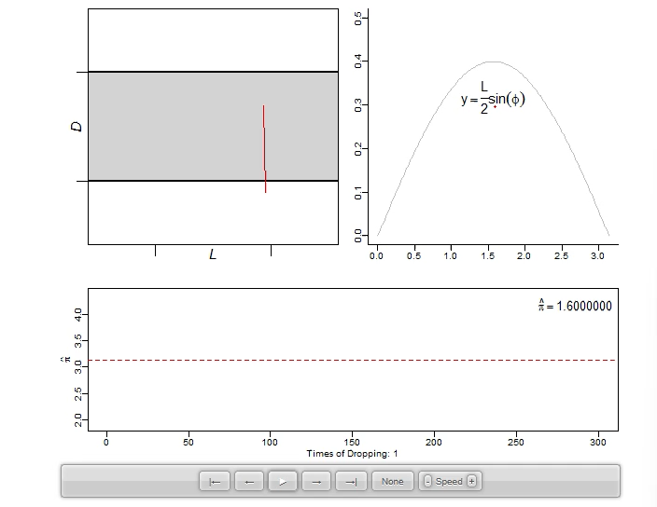
Graph illustration
After 1e6 needle drops, the probability of relative error exceeding 1% is approximately 0.012%
Notes:
disrupting traffic flow

Slide 14
Las Vegas algorithms
Basic Principle
Las Vegas algorithm is a randomized algorithm that always produces a correct result if it finishes, but its running time is random. It may take longer or restart, but never returns a wrong answer
Las Vegas算法是一种随机化算法，它若完成则始终给出正确结果，但其运行时间是随机的。它可能需要更长时间或多次重启算法，但不会返回错误答案
Feature
Guaranteed Correctness
Execution time is probabilistic → often with good expected performance
May report failure or retry if no solution is found quickly
Efficient to check if a candidate solution is correct

Slide 15
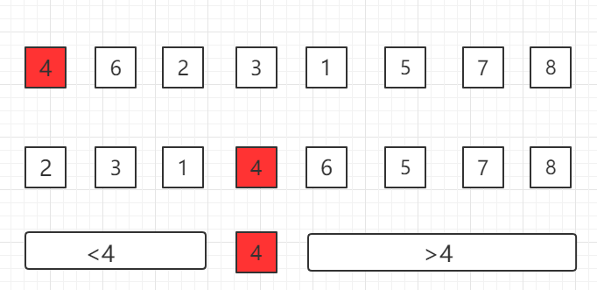
Example: Randomized Quicksort
Basic Principle
The core idea of randomized quicksort is to introduce deliberate randomness to eliminate predictable worst-case scenarios
随机化快速排序的核心思想是引入人为随机性，以消除可预测的最坏情况
Algorithm Flow
Choose a random element from the array as the partition pivot
Rearrange the array → elements less than the pivot are on its left and greater elements on its right
Apply the same randomized sorting process to the left and right subarrays
After recursion, the array is fully sorted as each pivot is already in its correct final position
Notes:
disrupting traffic flow

Slide 16
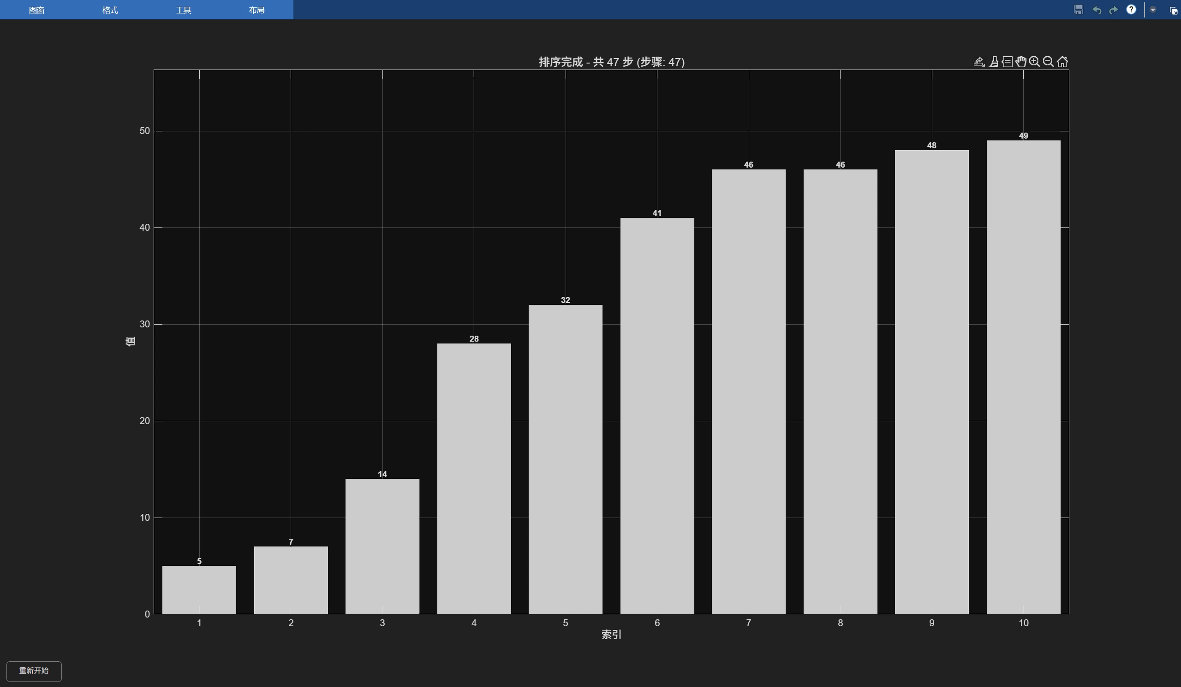
MATLAB illustration
Notes:
disrupting traffic flow

Slide 17
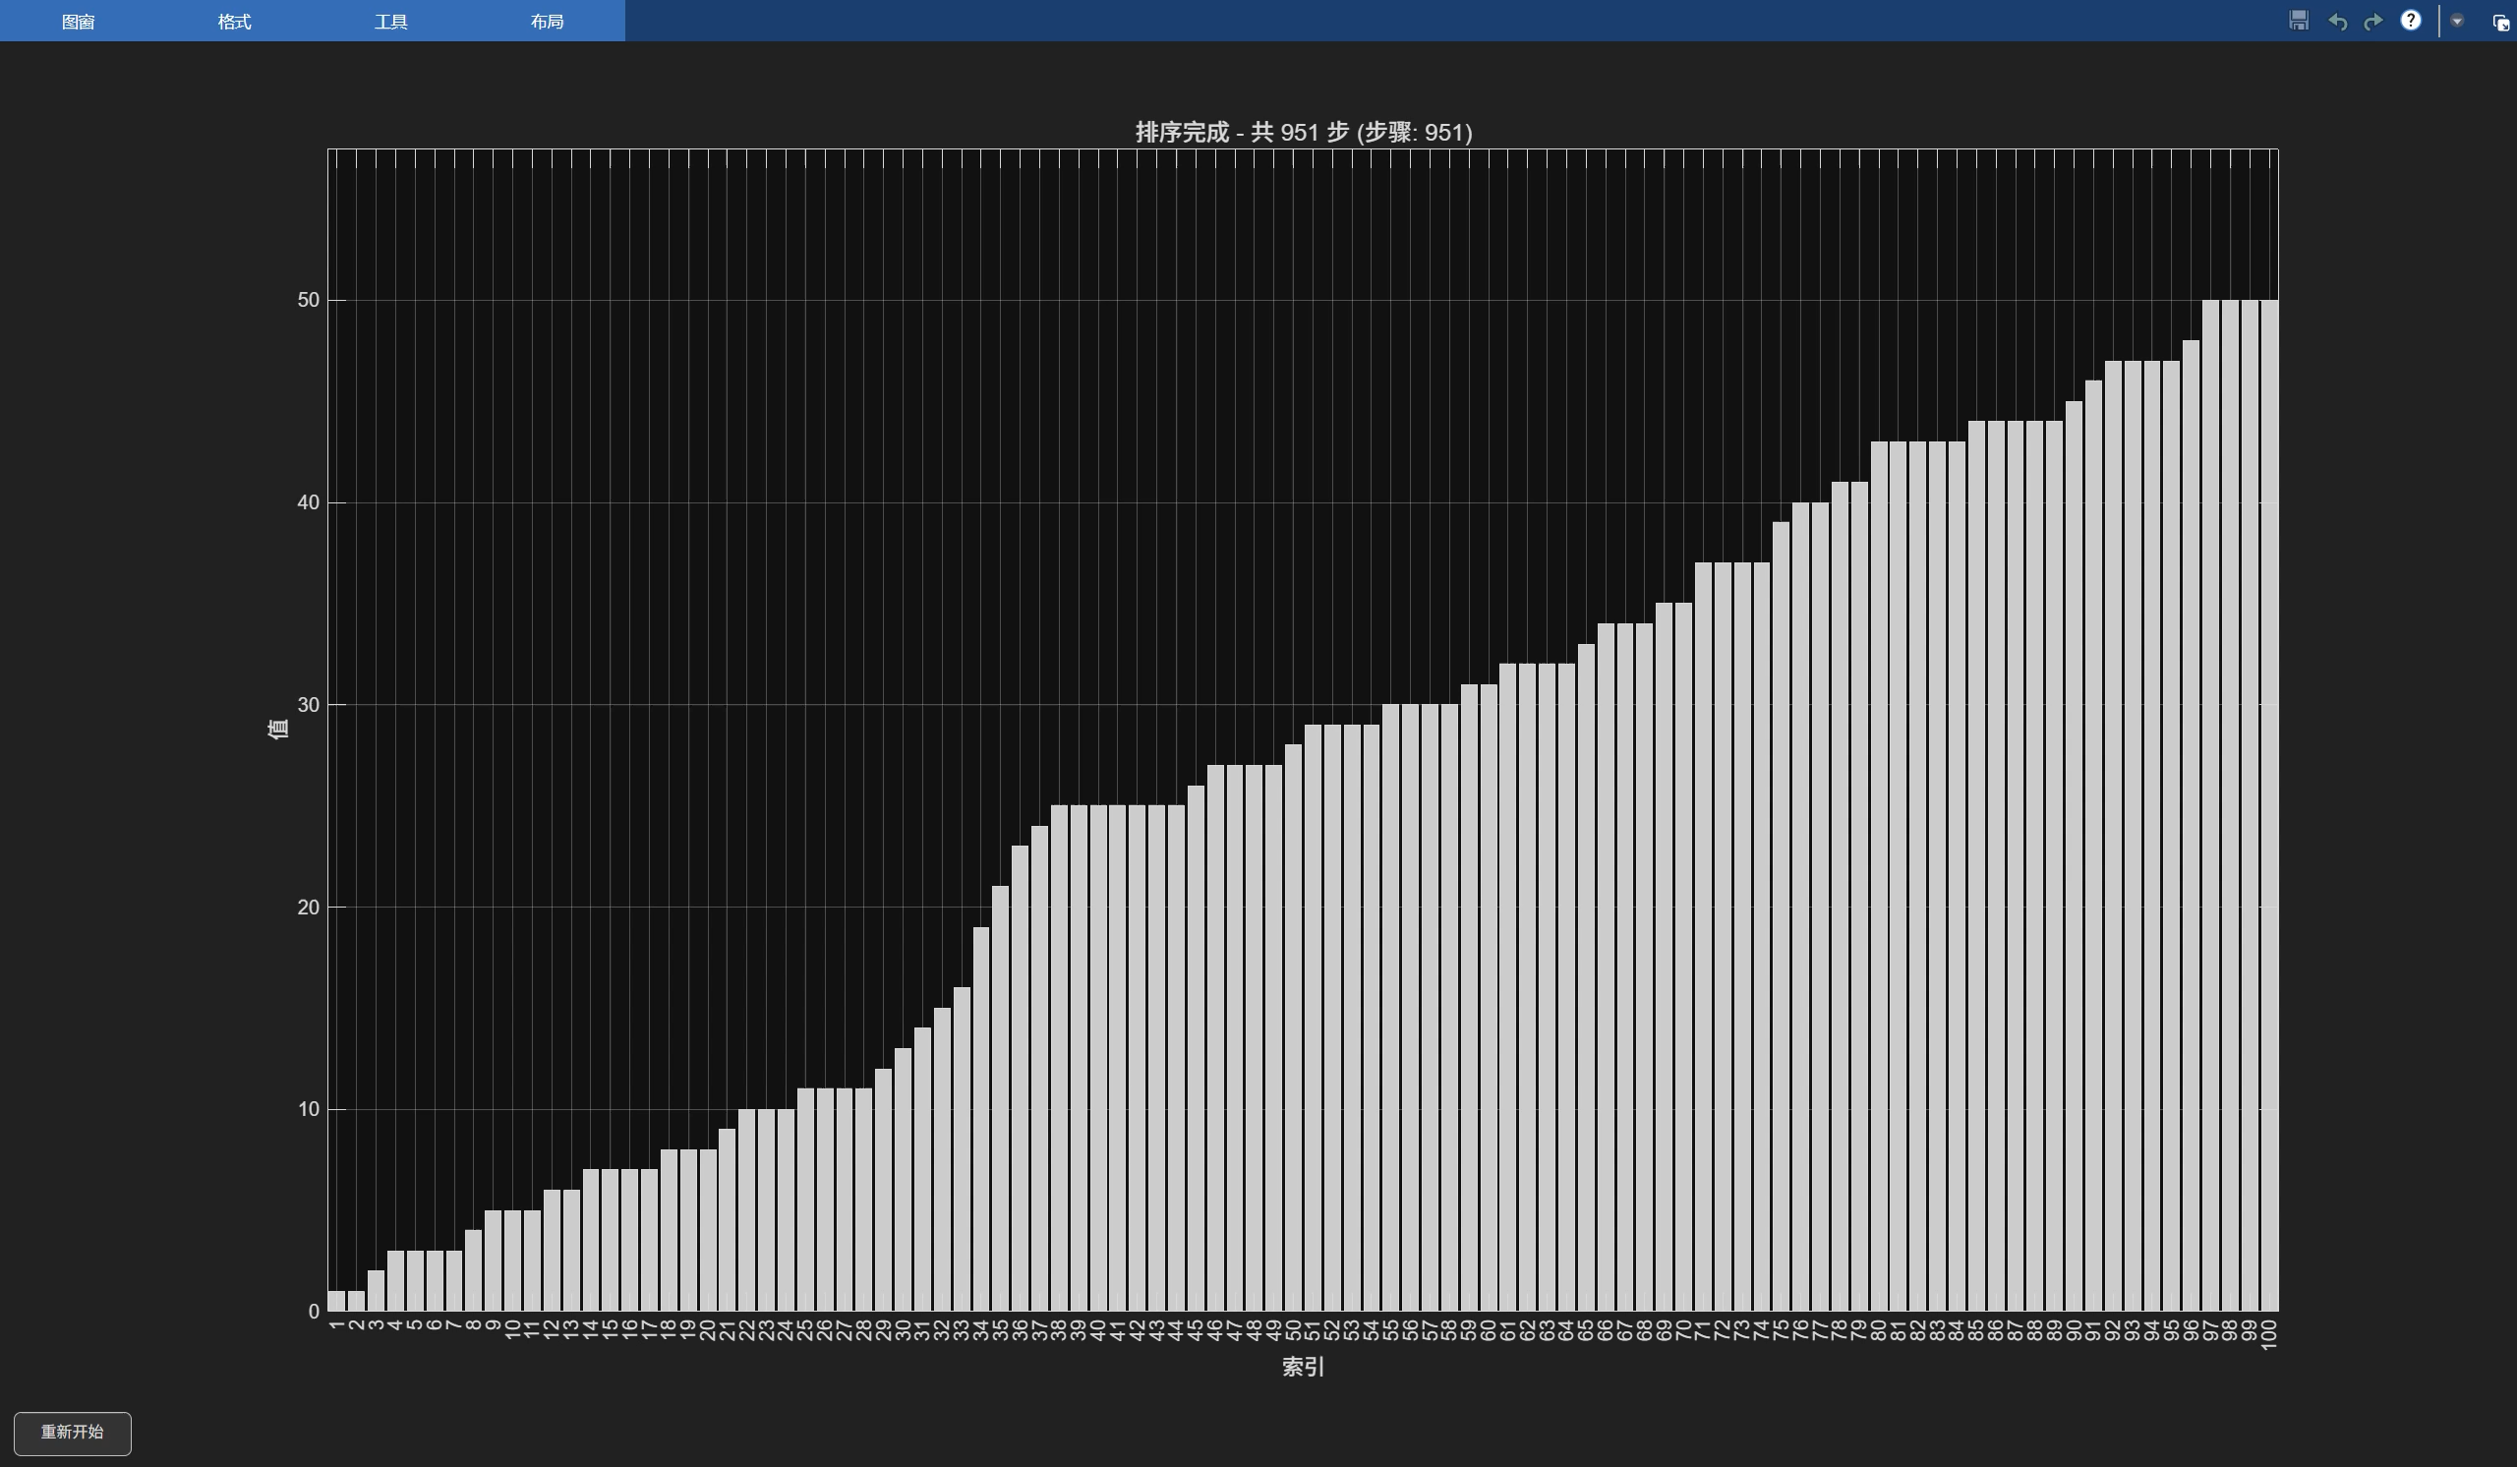
MATLAB illustration
Notes:
disrupting traffic flow

Slide 18
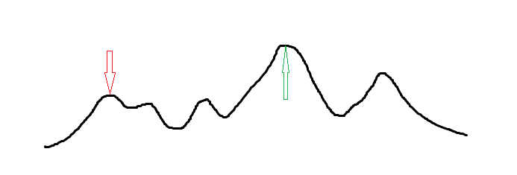
Hill Climbing Method
Basic Principle
Hill Climbing is a local search optimization algorithm that finds optimal solutions through iterative stepwise improvement. Starting from an initial solution, it continuously moves to better neighboring solutions until no improvement is possible. The algorithm is efficient but prone to getting stuck in local optima.
爬山法是一种基于局部搜索的优化算法，通过逐步迭代改进当前解来寻找最优解。它从初始解出发，不断移动到更优的邻域解，直到无法改进为止。该算法运行效率高，但容易陷入局部最优。
Feature
Fast convergence on smooth, single-peak problems
Often gets stuck in local optima
Only accepts improving moves
High dependence on Initialization

Slide 19
Simulated Annealing
Basic Principle
Simulated annealing is a global optimization algorithm that introduces randomization and a "temperature" parameter to search for global optima. Initially, at high temperatures, the algorithm explores more regions to find better solutions, while also accepting worse solutions with a certain probability to avoid local optima traps. As temperature gradually decreases, the algorithm stabilizes and gradually converges toward the optimal solution region, ultimately yielding a correct result.
模拟退火是一种全局优化算法，引入了随机化和 “温度” 参数以寻找全局最优。最初，在高温下，算法会探索更多区域以寻找更好的解，同时以一定概率接受较差解以避免局部最优陷阱。随着温度逐渐下降，算法趋于稳定并逐渐收敛到最优解区域，最终得到正确的结果
Feature
Higher temperature allows exploring diverse regions
Temperature decreases over time to stabilize convergence
Uses a probability function to decide whether to accept inferior solutions
Escape local optima to search for a global optimum

Slide 20
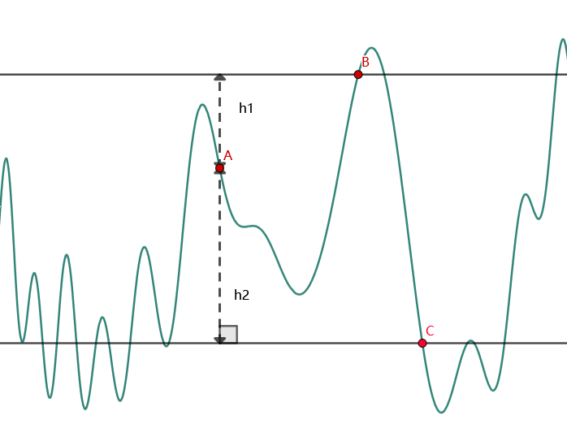
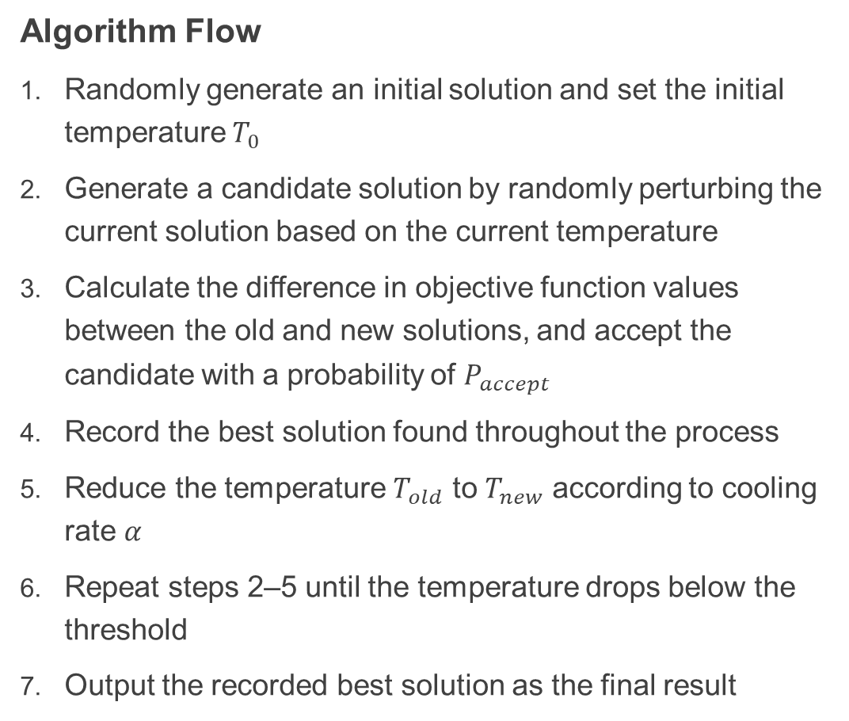
Simulated Annealing
Algorithm Flow
Randomly generate an initial solution and set the initial temperature $T_{0}$
Generate a candidate solution by randomly perturbing the current solution based on the current temperature
Calculate the difference in objective function values between the old and new solutions, and accept the candidate with a probability of $P_{accept}$
Record the best solution found throughout the process
Reduce the temperature $T_{old}$ to $T_{new}$ according to cooling rate $α$
Repeat steps 2–5 until the temperature drops below the threshold
Output the recorded best solution as the final result

Slide 21
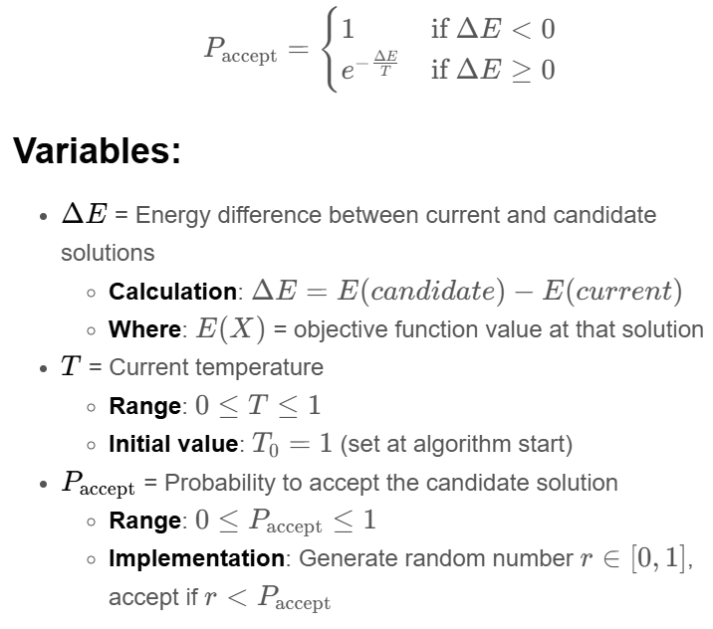
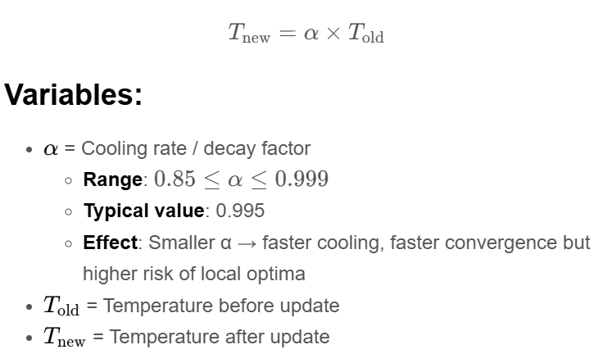
Simulated Annealing
Core Formula

Slide 22
Simulated Annealing
Applicable Conditions
Problem can be represented as a state with a definable cost/energy function
A method to generate neighboring states (small changes to current solution)
A computable cost/energy difference between current and new state
A cooling schedule defining temperature decrease over iterations
Acceptance probability function (typically Metropolis criterion)
Suitable parameters (initial temperature, stop condition, iteration limits)
Nondeterministic Polynomial time problems (NP Problems)
非确定性多项式时间问题
Verifying an answer is easy, but finding the answer is hard

Slide 23
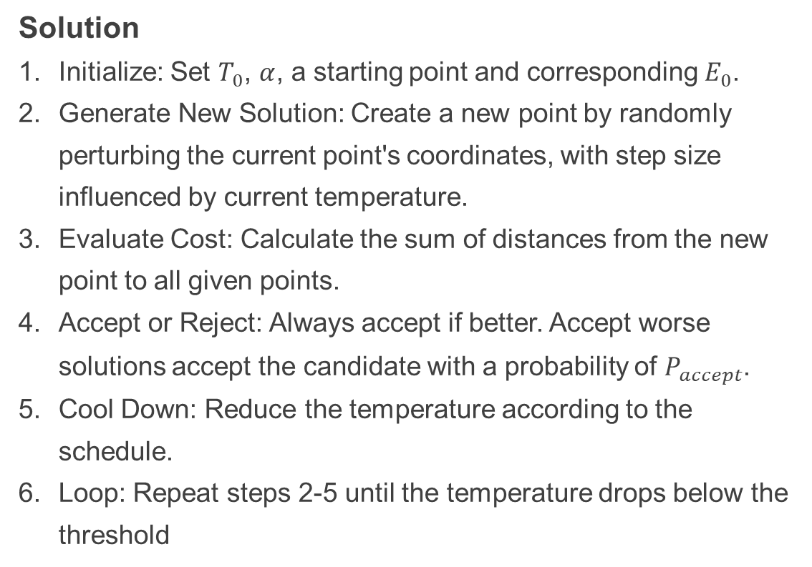
Example: The Fermat Point Problem
Solution
Initialize: Set $T_{0}$, $α$, a starting point and corresponding $E_{0}$.
Generate New Solution: Create a new point by randomly perturbing the current point's coordinates, with step size influenced by current temperature.
Evaluate Cost: Calculate the sum of distances from the new point to all given points.
Accept or Reject: Always accept if better. Accept worse solutions accept the candidate with a probability of $P_{accept}$.
Cool Down: Reduce the temperature according to the schedule.
Loop: Repeat steps 2-5 until the temperature drops below the threshold
C++ Code
Test case

Slide 24
Example: Traveling Salesman Problem (TSP)
Introduction
Find the shortest route visiting each city exactly once and returning to the start point.
Classic NP‑hard optimization problem
Exact solution becomes impossible for many cities
Used in logistics, manufacturing, DNA sequencing
Solution
Start with a random tour and high temperature.
Randomly swap two cities, accept new tour if better.
Occasionally accept worse tours early to explore.
Gradually reduce temperature until a stable solution is found.

Slide 25
Simulated Annealing
Algorithm Optimization
Multiple solutions anneal simultaneously, periodically exchanging discoveries
Combine promising segments from different chains to create new solutions
Dynamically adjust mutation magnitude based on search stage
Record poor solution regions to avoid revisiting
Assign different temperatures to different chains
Preferentially perturb high-quality or diverse solutions
Quick hill-climbing to a local peak after accepting a new solution
Population ideology
Cross operation
Adaptive mutation
Population gene pool
Selection pressure gradation
Selection operator
Memetic algorithms

Slide 26


Further: Genetic algorithm
Basic Principle
Genetic algorithm(GA) is a population-based optimization algorithm that uses mechanisms inspired by biological evolution—such as selection, crossover, and mutation—to iteratively improve a set of candidate solutions. It runs for a predetermined number of generations or until a convergence criterion is met, and generally returns a good but not guaranteed optimal solution within that finite time
遗传算法是一种基于种群的优化算法，利用受生物进化启发的机制——如选择、交叉和突变——来迭代改进一组候选解。它运行预定的世代数，或直到收敛准则满足，通常在有限时间内返回一个良好但不保证的最优解。

Slide 27




Application
…
Software Engineering Optimization
Computer Vision & Image Processing
AI & Machine Learning
Cybersecurity & Cryptography

Slide 28
Reference
https://oi-wiki.org/misc/random/
https://toddwschneider.com/posts/traveling-salesman-with-simulated-annealing-r-and-shiny/
https://www.di.fc.ul.pt/~jpn/r/animation/buffon.needle.html
https://www.163.com/dy/article/JMK0MMBV0521F5QQ.html
https://www.luogu.com.cn/problem/P1337
https://chat.deepseek.com/

